Slide 1
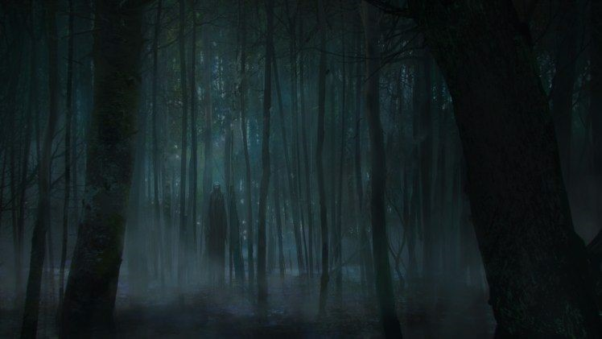
Horror “Movieland”
A chilling experience
Participants:
Giorgio Nocerino - 0124002311
Antonietta Giordano - 0124002421
Martina Raimo - 0124002358

Slide 2


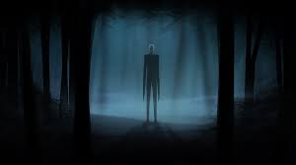
Goal of the project
The idea is to develop a web app capable of containing horror films and the like with unknown titles by sub-genre.

Slide 3
Features
Users are given the opportunity to collect their favorite movies and mark them in a section called Wish List, in order to keep track of the cinematic experience.

Slide 4
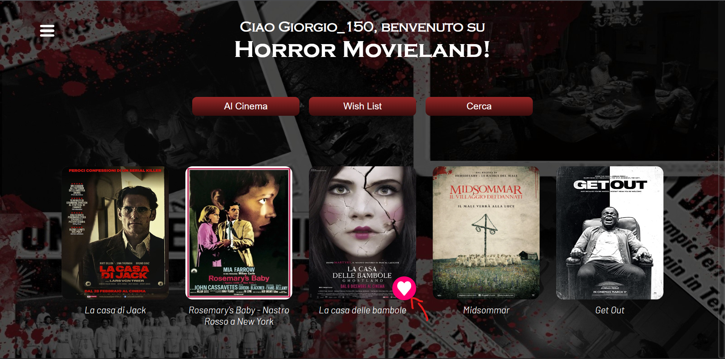
Here is the example

Slide 5
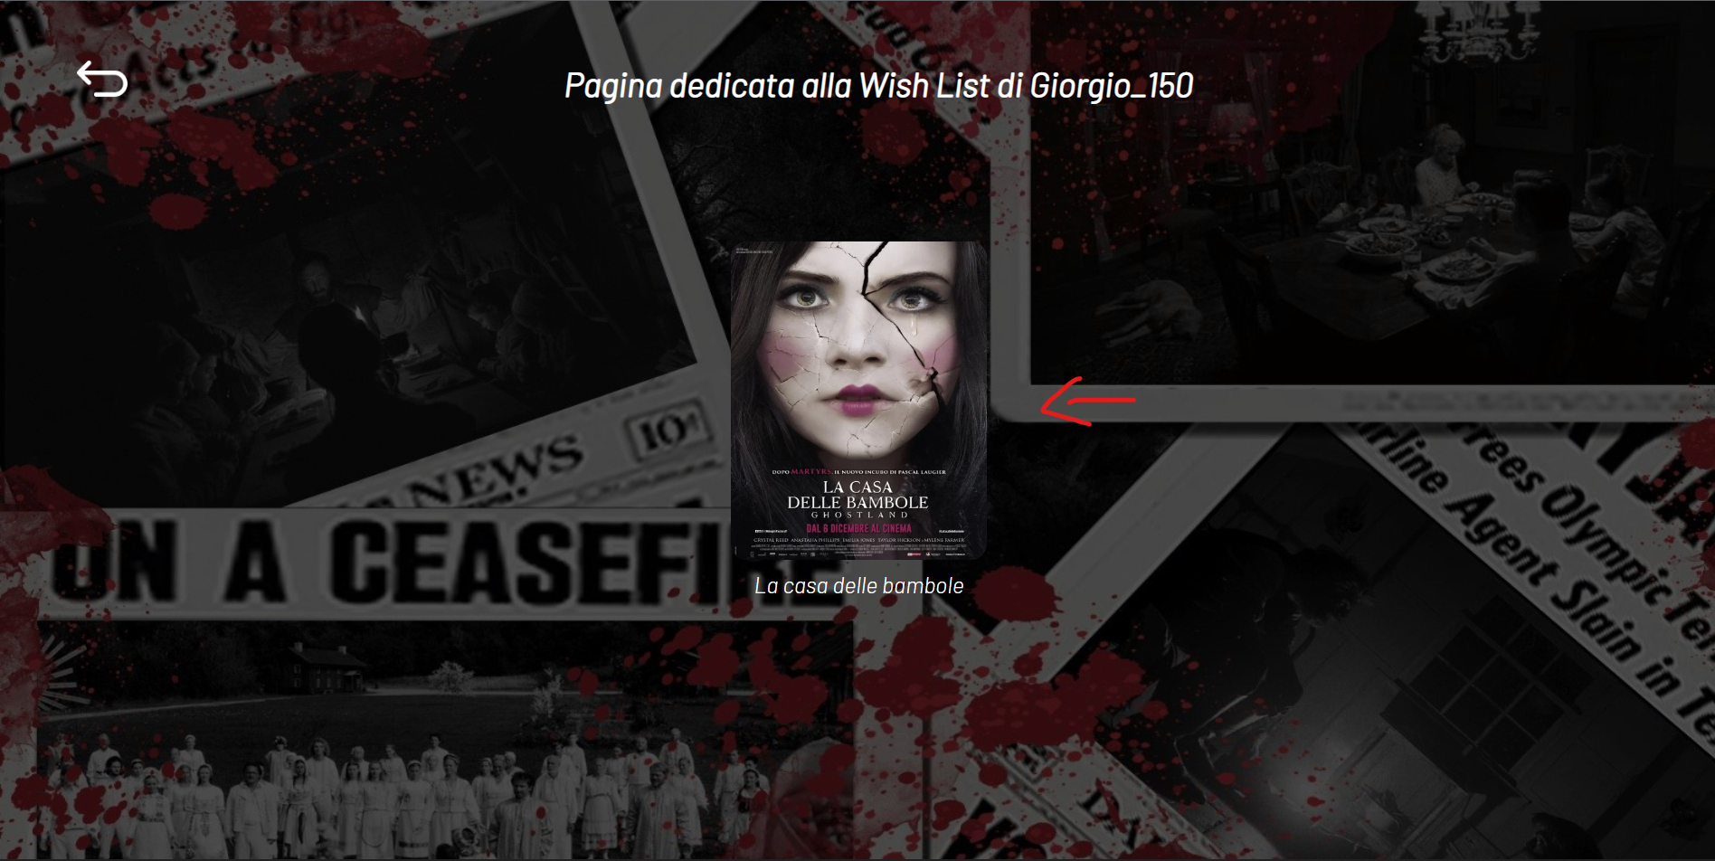
Here is the example

Slide 6
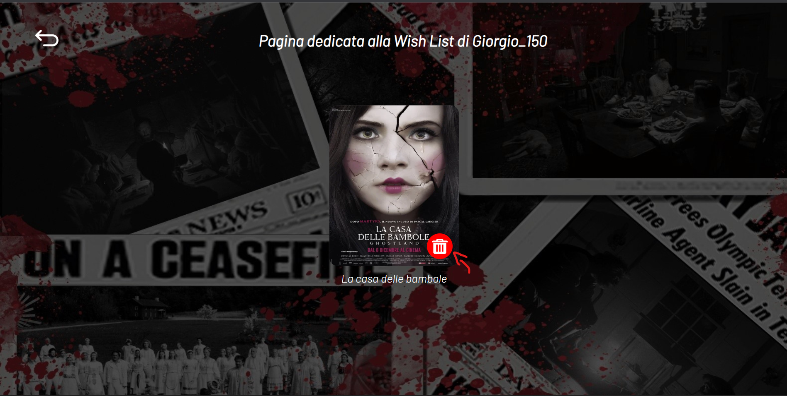
Here is the example

Slide 7
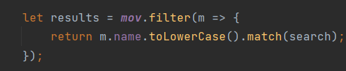
Search bar function
In technical terms, this function allows you to identify the keywords of the movie titles through the match command, which are saved in the json file and will appear as soon as we enter the keyword in the search bar.

Slide 8
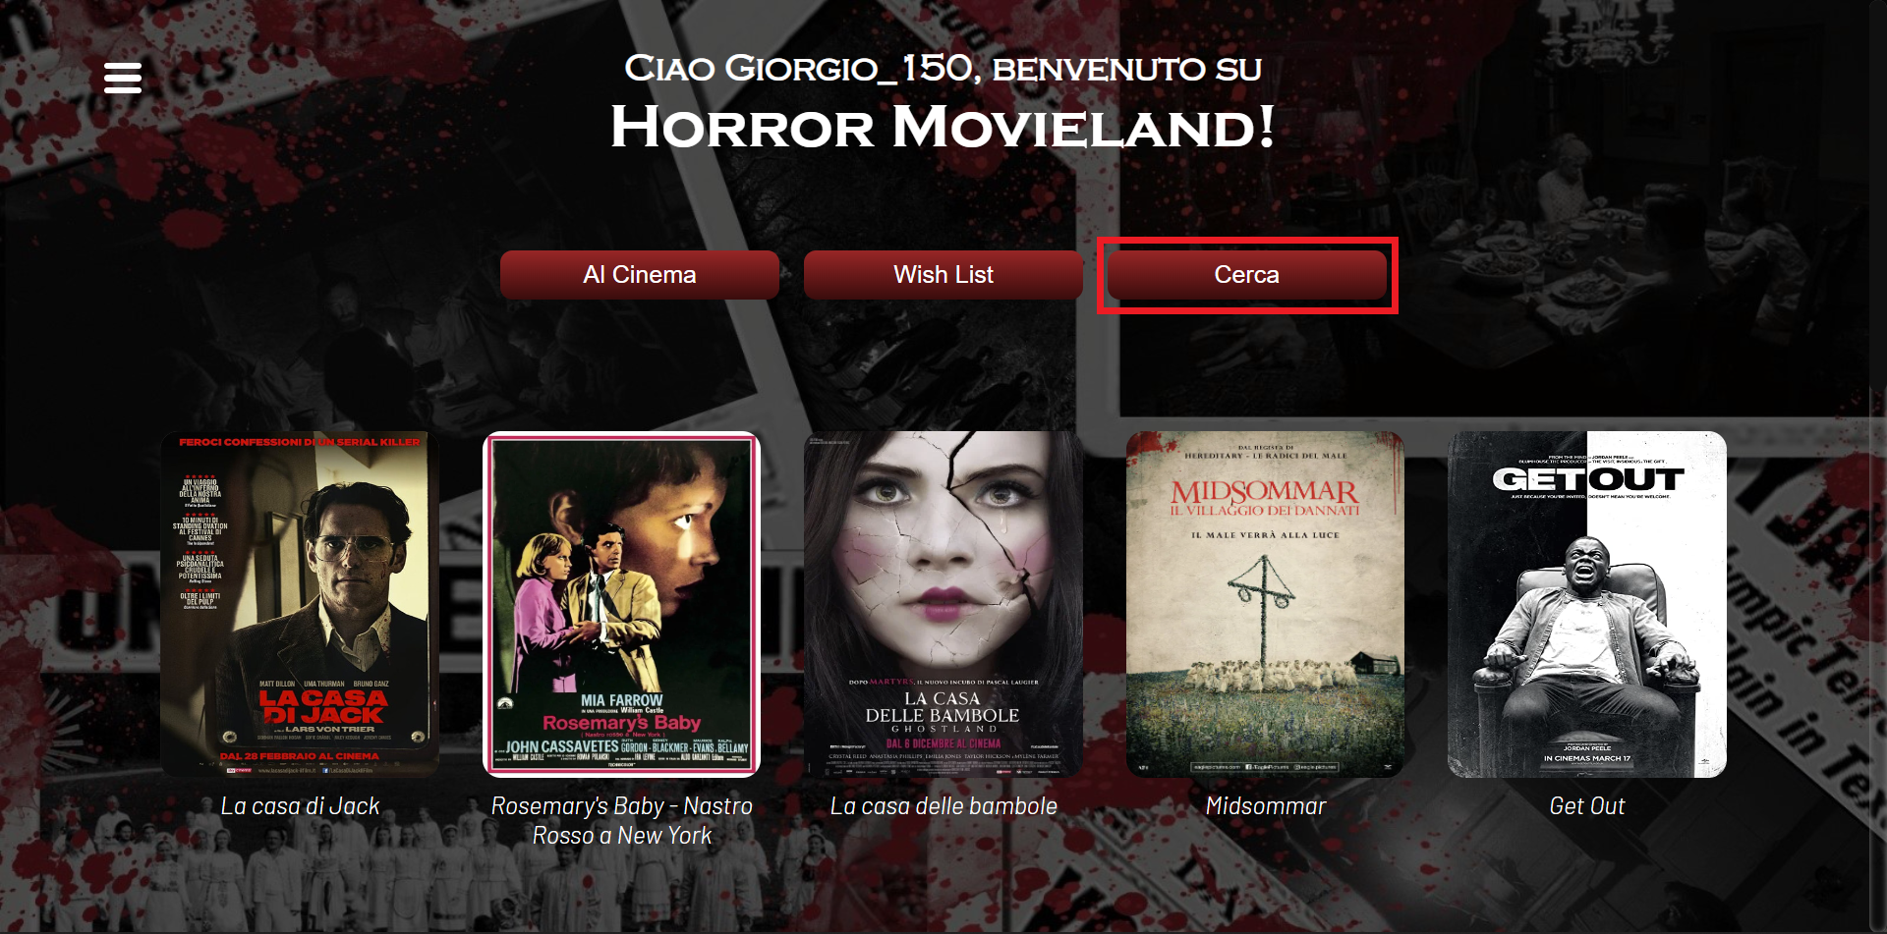
Example of search bar

Slide 9
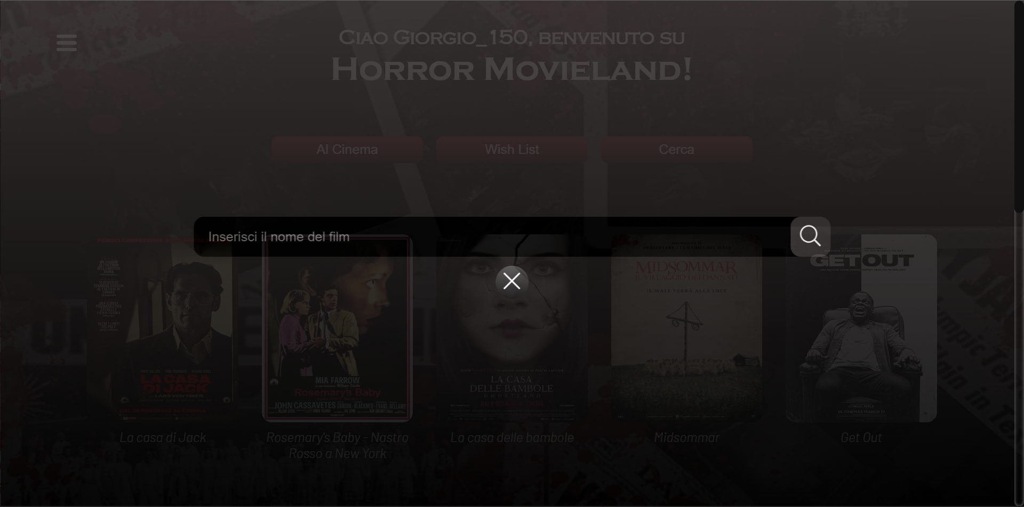
Example of search bar

Slide 10
Example of search bar

Slide 11
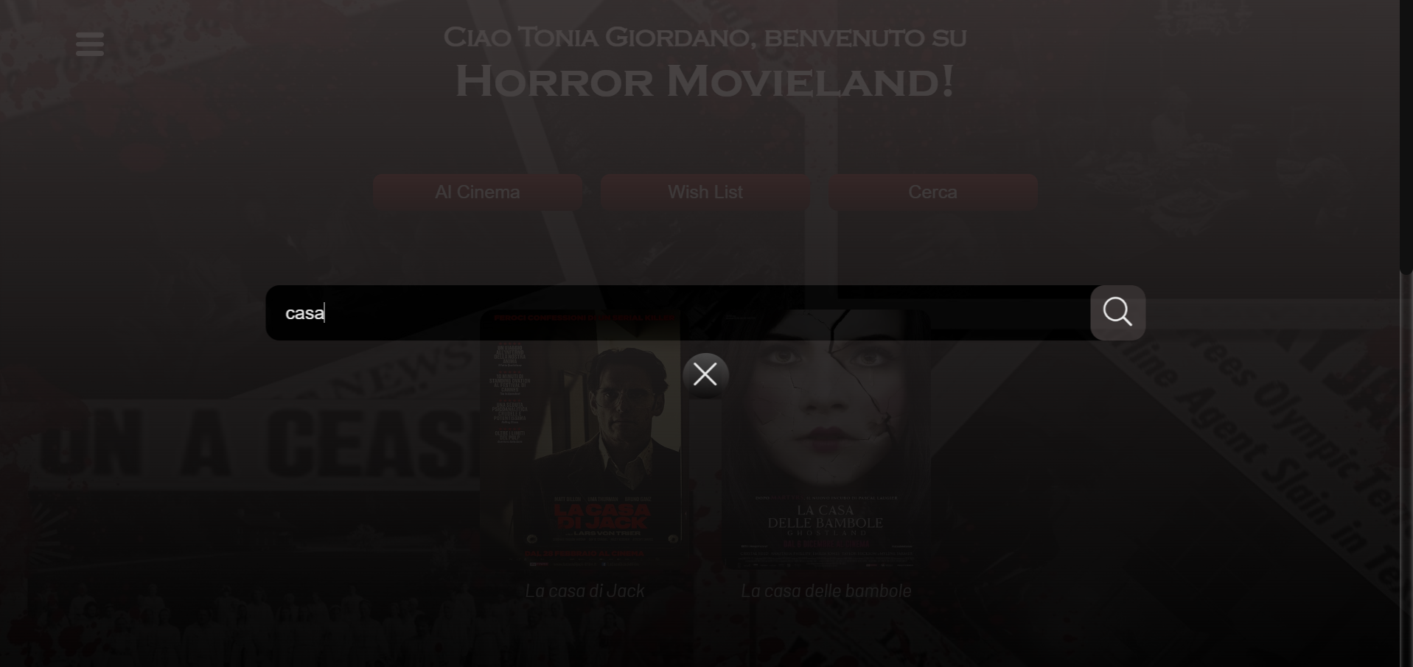
Example of search bar

Slide 12
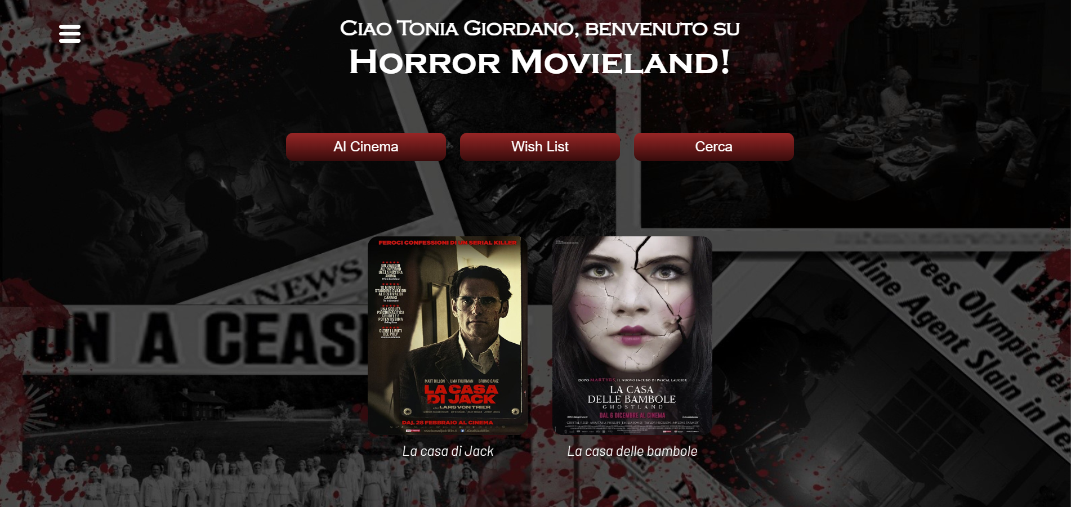
Example of search bar

Slide 13
Access via Google
Obviously, users before entering the homepage do not necessarily have to create an account but can also log in via Google.

Slide 14
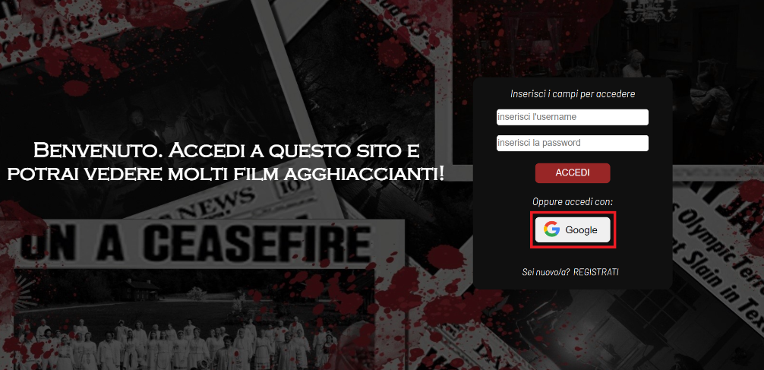
Example of access via Google

Slide 15
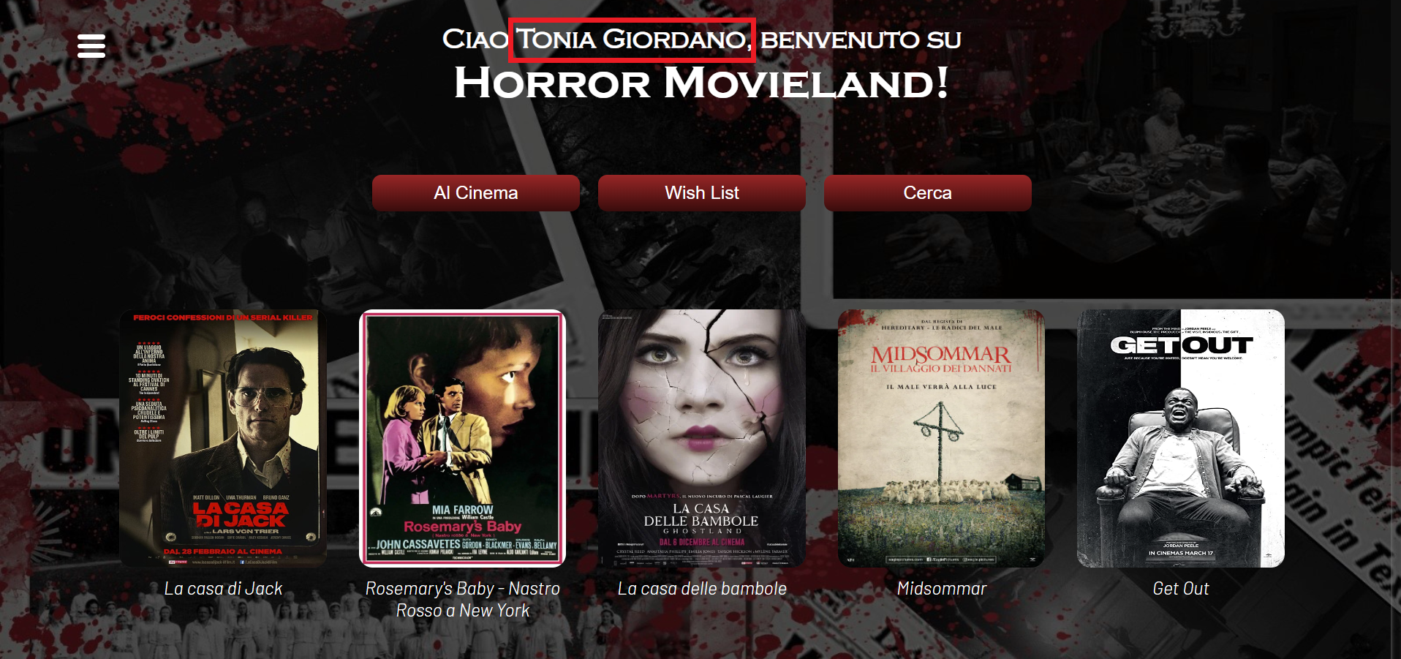
Example of access via Google

Slide 16
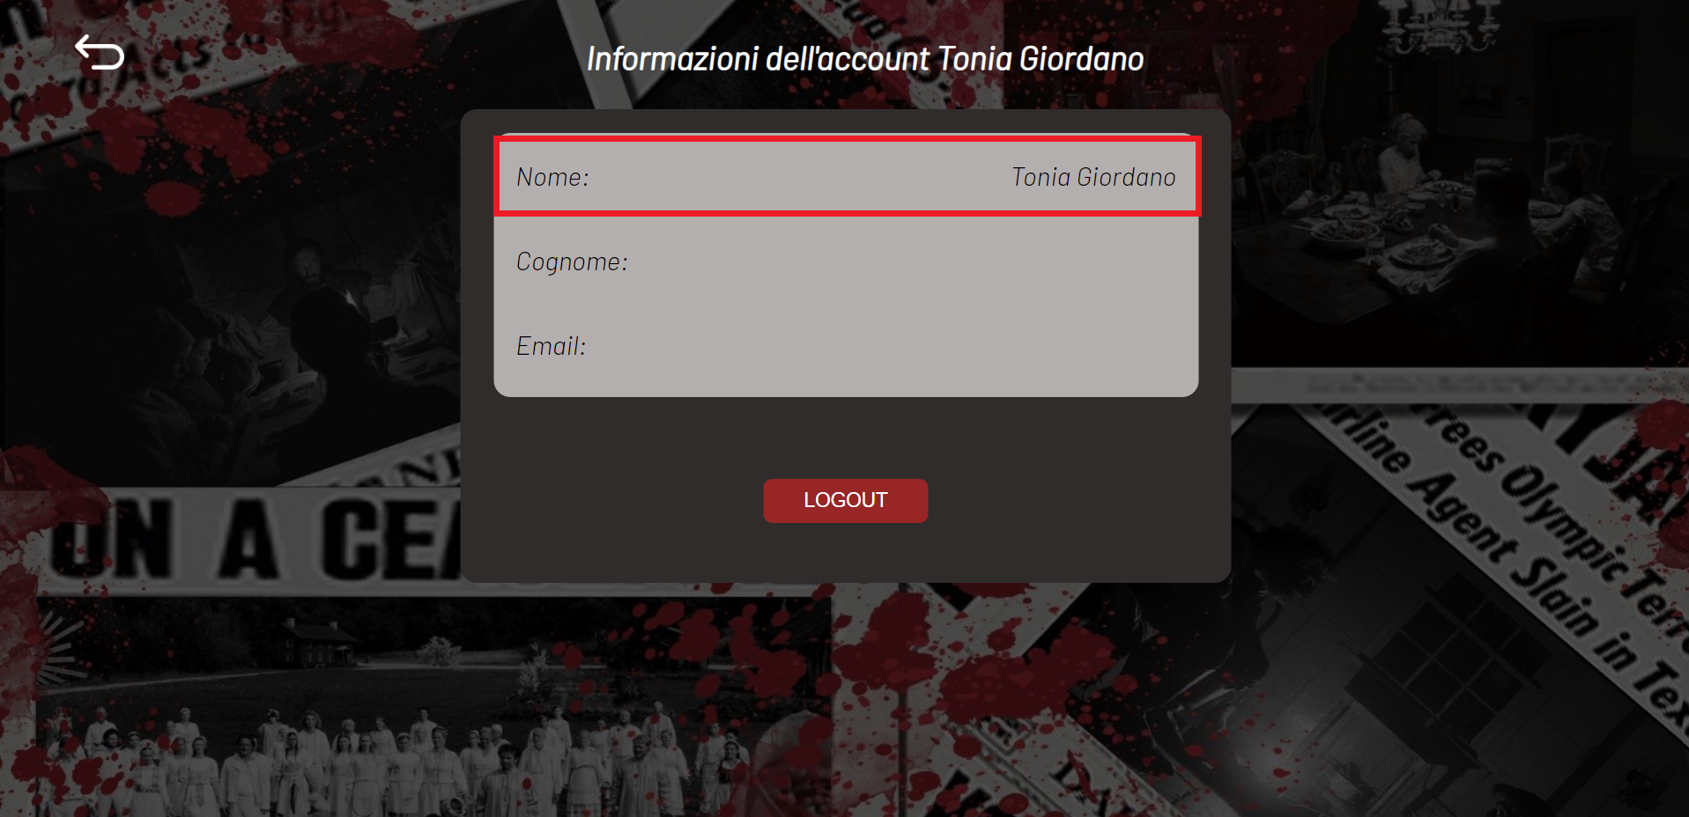
Example of access via Google

Slide 17






Languages used
Front-end side: HTML5, CSS3, JS
Back-end side: Python (with framework: Flask)
Other: DB (SQLite)

Slide 18
THANKS FOR THE ATTENTION

